Slide 1

Week 10 + 11 – Identity Management
CPAN212 – Modern Web Technologies

Slide 2
Agenda
Building a User system
What do we store
How do we store it
Hashing passwords (bcrypt.js)
Saving user sessions and JWTs
Using other services to handle our user states (passport.js)

Slide 3
Consider the last time you made an account
What information did they need?

Slide 4
Based on last weeks book model, lets make a user model
Take the information we just talked about and make a model out of it
Here is an example, what do you NEED vs WANT:
Email
Password
First name
Last name
Phone number
Profile picture

Slide 5
What about the password
We cant just store it as plain text
So we should encrupt it
How to protect your site – if someone gets into your database and steals all your users’ passwords that are stored in plain text?
Encrypt password-field in the database when a user registers and when they try to login, encrypt their plain text password that is sent to the server over a HTTPS POST request, encrypt it and compare the encrypted passwords for a match.
A great node.js library to use for the one-way encryption of passwords is bcrypt.js

Slide 6
Bcrypt.js
Install bcrypt.js using npm – and include it in your solution using:
const bcrypt = require('bcryptjs’);
This hashes the password using famous hash algorithms like:
md5, sha224, sha256, sha512, etc.
bcrypt - npm (npmjs.com)

Slide 7
Hashing and salting
Adding a salt to a hash increases its security
A salt is just an extra sequence of characters added to the password
Proper salts can render rainbow table attacks useless
The salt needs to be stored together with the hash
We will use Bcrypt

Slide 8
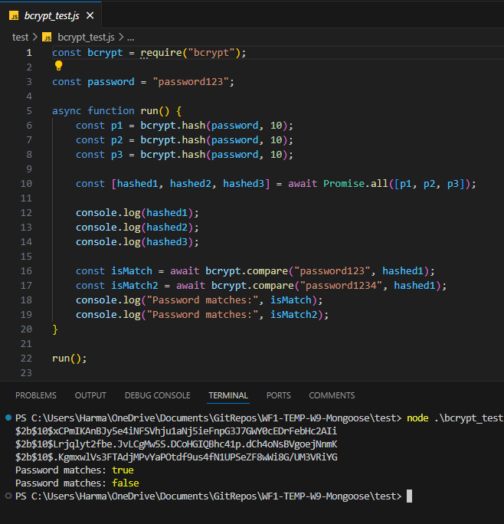
compare the “hashed” text

Slide 9
So, what's next
We established the schema
We need to make the routing
Register
Login
logout
We need to make the webpages to pass information along
Register needs all the information
Login: email and password
Logout: Does this need to be a page or an action?

Slide 10
HTTP is stateless
HTTP is called as a stateless protocol because each request is executed independently, without any knowledge of the requests that were executed before it
The question is How to make HTTP “act” stateful?
And before that : Do we really need to make HTTP behave stateful?

Slide 11
To make HTTP act stateful
Session
Session is an object which is stored on a web server
web session ID is stored in a visitor’s browser to track sessions.
This session ID is passed along with any HTTP requests that the visitor makes while on the site
Cookie
is a small piece of data in “{name}={value}” pair which is stored on the client side

Slide 12
There are a lot of ways to achieve the same result
I used:
express-sessions and mongo store
In this class its passport.js
In some real world cases you move the hard work to a 3rd party service, i.e AWS

Slide 13
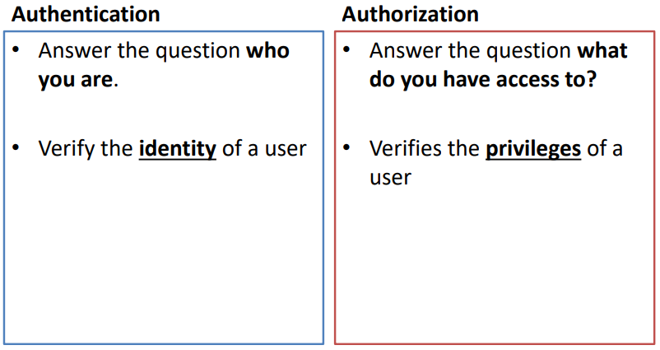
Differences between Authentication vs Authorization

Slide 14
Remember these
HTTP response status codes – can be used by your application to inform the browser of whether a request was rejected because of an authentication problem or an authorization problem.
401 status code (Unauthorized) Authentication error. The resource exists but it requires the user to be authenticated first to view it. It may also require permissions and be checked again after authenticating for proper authorization.
403 status code (Forbidden) Authorization error. The resource exists but the user does not have permission to view it.
404 status code Not Found. The resource that was requested was not found on the server. This is commonly used when a url is requested that just doesn’t exist.

Slide 15
Web Security
What is Web App Security?
→ AAA – Accounting DB table: users, Register()/ Sign Up
Authentication: Who are you? Login()
Authorization
What can you do? What resource can you access?
e.g.: Securing routes in data-service.js of an app/api
To ensure AAA
http -> https -> certification
Db users: password encryption
bcrypt.js
Session management

Slide 16
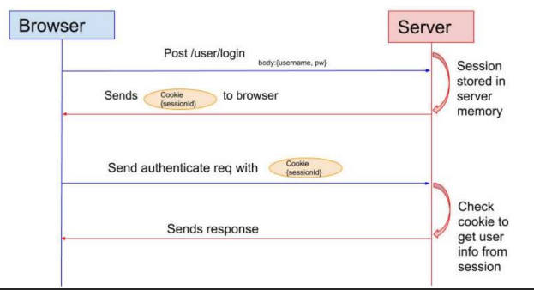
Web App Security
Session based authentication:
State management – First http request: login > session created on server > encryption > cookie > save in users' browser by using client-session.js
In all following http requests/responses, the session is attached

Slide 17
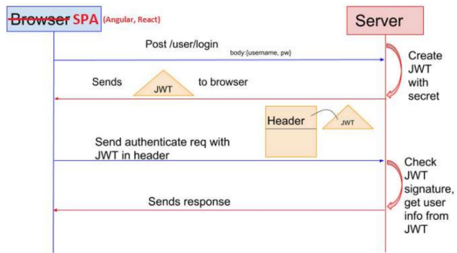
Securing a WEB API
WEB API:
No UI, no browser, no session
JWT(JSON Web Token)
Token based authentication
Similar to session based, but it’s for Web API

Slide 18
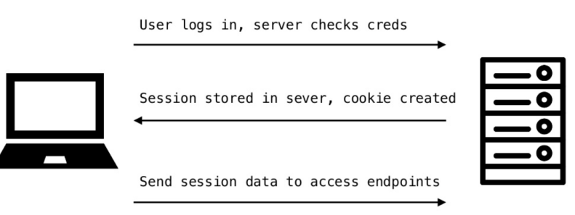
Traditional Authentication System

Slide 19
Issues with traditional systems
Sessions: Record needs to be stored on server (Space problem)
Scalability: With session in memory, load increases drastically in distributed system
CORS: When using multiple devices grabbing data via AJAX requests, we may run into forbidden requests.
CSRF Attacks: Riding session data to send commands to server from a browser that is trusted via session.

Slide 20
JSON web tokens (JWT)
A JSON web token, or JWT for short, is a standardized, optionally validated and/or encrypted container format that is used to securely transfer information between two parties.

Slide 21
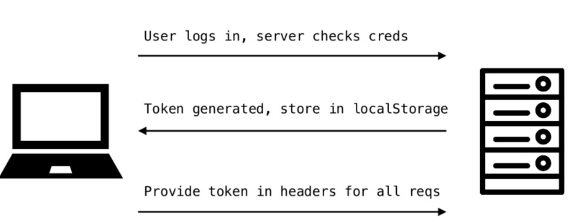
Token based Authentication Systems

Slide 22
What is JWT
Official website: – https://jwt.io/
RFC: – https://tools.ietf.org/html/rfc7519

Slide 23
JWT Benefits
They are contained and help maintain stateless architecture
The work well across multiple programming languages

Slide 24
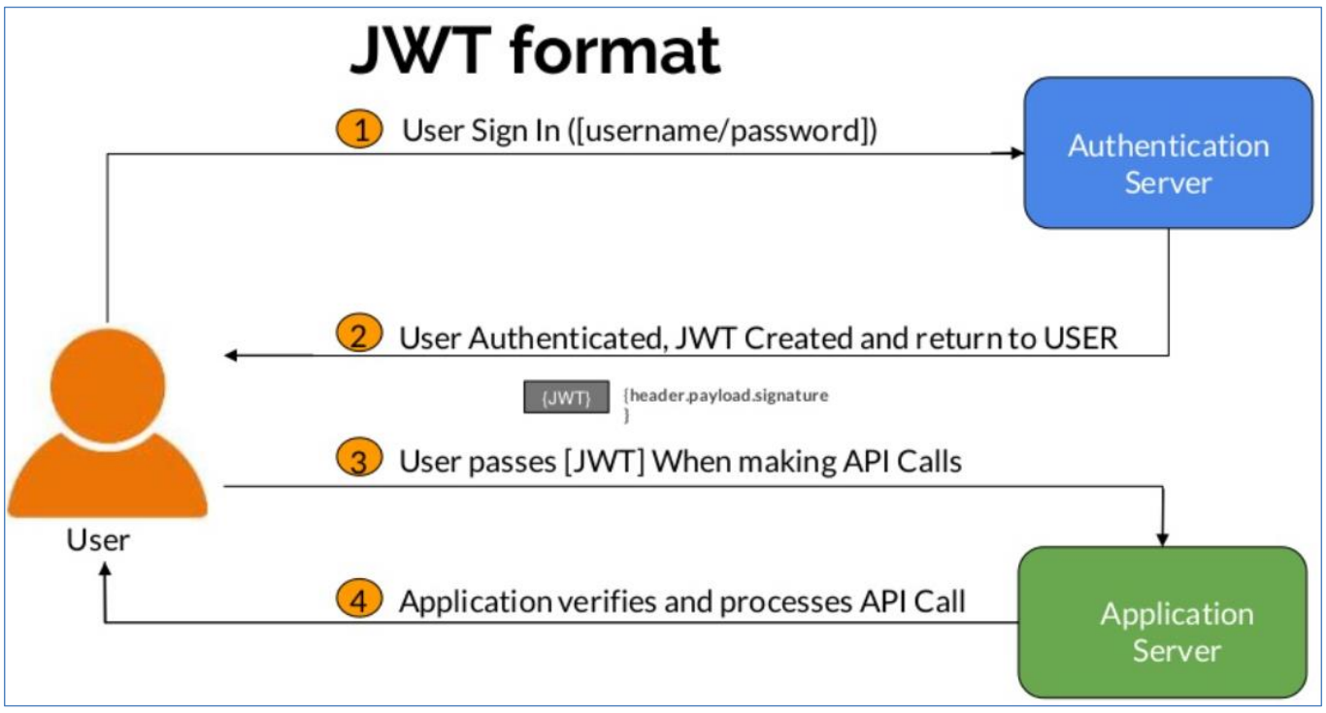
JWT workflow

Slide 25
JWT Format
JSON Web Token (JWT) is a compact URL-safe means of representing claims to be transferred between two parties
Header.payload.signature
Every JWT carries a header with claims about itself.
These claims establish the algorithms used, whether the JWT is signed or encrypted, and in general, how to parse the rest of the JWT.
The payload is the element where all the interesting user data is usually added.
The purpose of a signature is to allow one or more parties to establish the authenticity of the JWT
JWT Handbook:
https://auth0.com/resources/ebooks/jwt-handbook/thankyou

Slide 26
JWT Format
Header.payload.signature
Header: consists of two parts:
The type of the token, which is JWT
The hashing algorithm being used, such as SHA256 or RSA
For example: { – “alg”:HS256”, – “typ”:”JWT”}

Slide 27
HMAC SHA256 vs RSA SHA256
HMAC SHA256: Symmetric key cryptography, single shared private key.
Faster
good between trusted parties.
RAS SHA256: Asymmetric key cryptography, use public/private keys
Slower
Good between untrusted parties

Slide 28
Reserved Claims
iss (issuer)” The person that issued the token
sub (subject): The subject of the token
aud (audience): Audience the token is intended for
nbf (not before): Starting time token is available
iat (issued at): When the token was issued.
jti (JWT ID) : Unique identifier for the token
exp (expiration) : Time the token expires

Slide 29
Payload: Example
var payload = {
sub : ‘456598’,
exp : ‘12345678’,
jti: ‘841234’,
role: ‘admin’ }

Slide 30
Identity Management
User Registration
Creation of user accounts
Account Verification
Authentication
Username and Password
MFA – MultiFactor Authentication
Biometrics
Attributes and Meta data: Stores information about you on a Database
Password Management
Establishes rules for password creation and management (Length and Complexity)
User Profile Management
Authorization
Access control for users or websites to what resources are accessible

Slide 31
We can use Middleware to handle the task
Instead of building out a comprehensive management service(s) we can use already existing and secure programs created by others
You can break down developers as:
People who make things
People who make the tools to help people make things

Slide 32
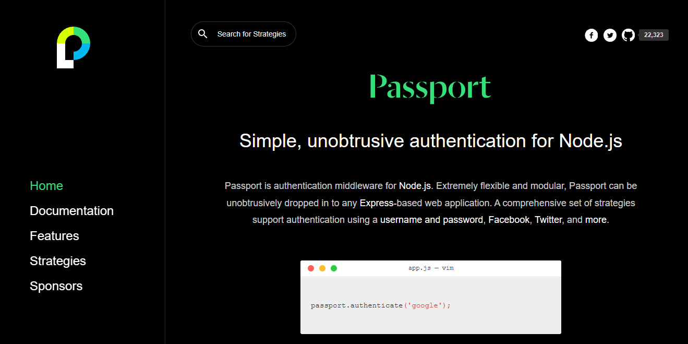
PASSPORT.JS
Authentication middleware for Express
Flexible and modular
Authentication using email, username, and password
Login strategies using Google, Facebook, OAuth, and more
Local login strategy
Passport.js (passportjs.org)

